Slide 1
Learning
Partner
Training

Slide 2

Passport Guidance Notes
Learning Partner role, tasks and process
Passport Process
Recognition of Prior Learning
Supporting Leaders & Managers with disabilities
First Aid requirements
Overview of each qualification
Guidance on activities

Slide 3

Qualification Summaries
Each Qualification includes role based activities, reading and reflection exercises.
Tailored face to face training programs complement the Passport.

Slide 4

Support from start to completion of Qualification
Personnel
District/Region Manager
Learning Partner
Other Leaders/Managers
Region/State Team

Slide 5

Procedures
Induction
Meetings – DM/RM, District/Region, Learning Partner
Training – webinar, induction, First Aid, State training
Completion of passport activities

Slide 6

Learning Partner Role

Slide 7
What are the requirements
of the role of :
Learning Partner?
Qualified Leader?
District Manager?
Notes:
Conduct an activity that allows participants to see the different roles, who does what and that it is team effort – LP, QL and DM/RM must work together to support the NYQL or NYQM or NYQOL
Find out if anyone is a prospective Manager or Outdoors LP
Explain that the process is the same for UL and DM and OL as far as the support and signing off the passport is concerned. We will be talking mainly UL throughout the day but the process is the same.
Ensure that everyone has access to the Guidance Notes for this activity – pages 7-12
It needs to be stated that the Passport is a learning experience, the activities do not need to be perfect to be acceptable.
The idea is that through each experience the NYQ Leader can learn from the activity and see how it could/should be done differently or adapted to suit the needs of a different group of girls
The District Manager can only be a Learning Partner for another District Manager, which is why she cannot be appointed the Learning partner for her district. The Learning Partner is appointed to the district not the leader, she then works with all the new leaders within the district.
If you are lucky enough to have a significant number of new leaders a second Learning Partner can be appointed
It can be mentioned here that the QL talking with the girls and letting them know that the new leader needs to earn her leaders badge and she needs to plan some of the activities is a way of having the girls involvement and understanding and hopefully this will enable the process to be moved along better and quicker.

Slide 8

Exercise
Notes:
The individual roles, tasks and responsibilities of the LP, QL and DM have been placed on cards and cut up. Participants are to place the tasks under the heading they believe is correct. If possible leave this up all day – if in the training room at Glengarry this could go up on the blackboard.
It is the task of the LP and DM to ensure that the QL knows her role and that she is responsible for signing off parts of the Passport

Slide 9
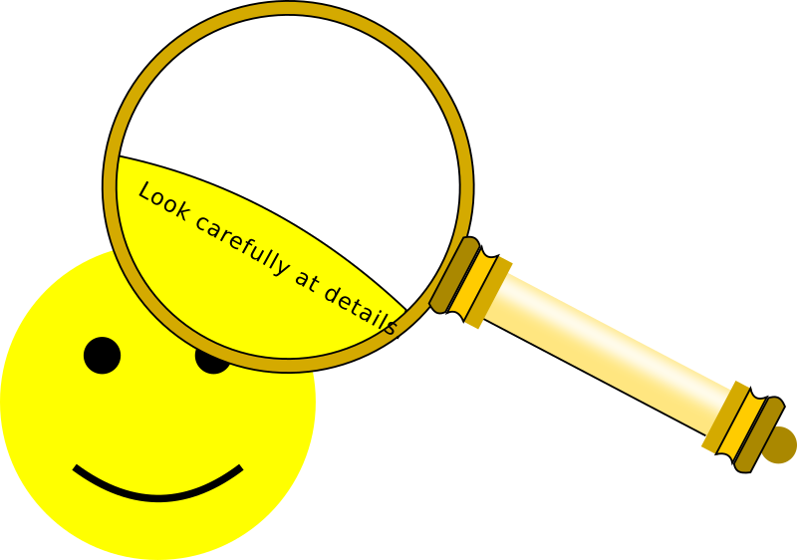
Passport
How many Activities does the Qualified Leader have to sign in the Leadership passport?
Notes:
There is a coloured handout to show what activities are signed by which party.
Hand this out after the questions have been asked.
Give the participants the passport and get them to work it out.

Slide 10

21 activities
12 shared with the Learning Partner

Slide 11
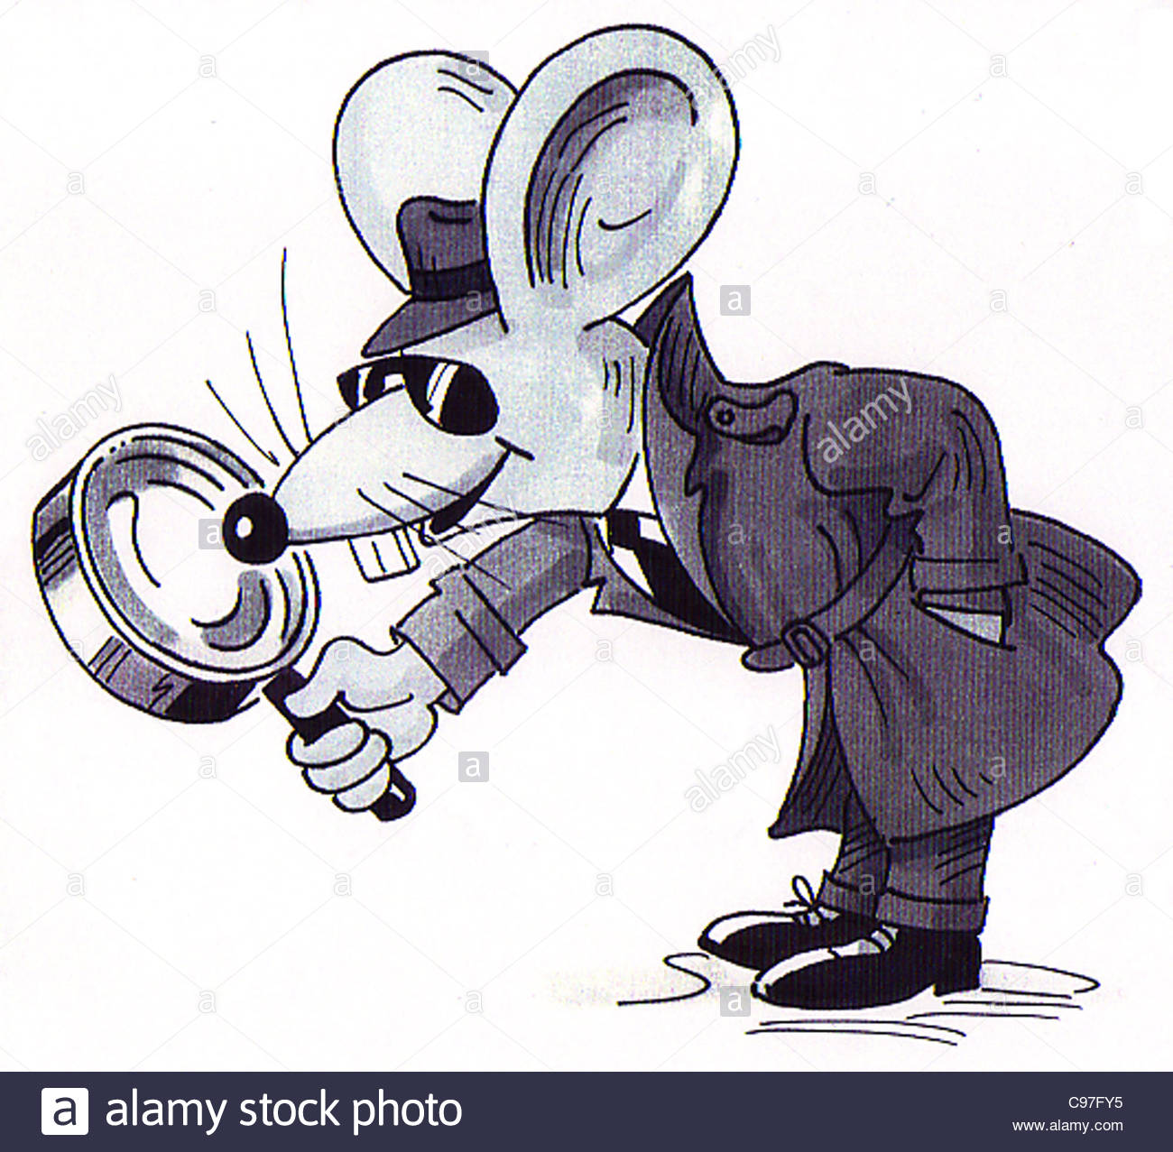
How many activities does the
Learning Partner sign?

Slide 12

12
Plus 12 shared with the Qualified Leader

Slide 13

How many activities does the
District Manager sign?

Slide 14

10
All can be done at a District Meeting
Notes:
If regular meetings are held and with some planning all the modules could be signed at a district meeting.
Go back through the passport to confirm this.

Slide 15

How many activities need to be
within the unit program?

Slide 16

13 activities
8 activities outside of meeting hours

Slide 17
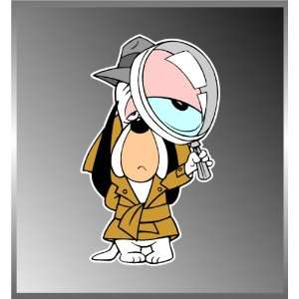
How does the qualified Leader
assess the other 8 activities?

Slide 18

Discussion
Evidence eg: forms filled out.
Third party evidence

Slide 19

Are there any activities the NYQ
leader can sign herself?

Slide 20

Yes – locate and check the First
Aid kit.

Slide 21

Quiz
Notes:
Let’s see what knowledge you have bought with you and what you have learnt so far!

Slide 22
What does ALQP stand for?
A) All Leaders Quiet Please
B) Australian Leadership Qualification Program
C) A Long Quiet Place

Slide 23

B) Australian Leadership Qualification Program

Slide 24
What are Primary Roles?
Unit Leader, Assistant Unit Leader, Outdoors Leader
B) District Manager, Region Manager
C) all of above

Slide 25
C) All of the above

Slide 26
Where can this information be found?
A) under a rock
B) by asking your Region L&D Advisor
C)Passport Guidance Notes

Slide 27
C) Passport Guidance Notes
Also on the GGA website – Leaders page
https://www.girlguides.org.au/leaders/
and on the GuideLines
website

Slide 28
What is the first thing a District Manager should do for her NYQ Leader?
A) Welcome her with a cup of tea
B) Appoint her a Learning Partner
C) Fill out membership forms and leader forms

Slide 29
C) Fill out membership forms and leader forms
Appoint a Learning Partner
all whilst having the cup of tea
In some states WWC check needs to be done before she is allowed to work within the unit

Slide 30
When should the Induction be filled out?
A) Sometime before the passport is completed
B) As soon as possible
C) Do I have to fill it out?

Slide 31
B) As soon as possible

Slide 32
Who fills out the Induction?
A) The qualified Leader
B) The District Manager
C) The Learning Partner

Slide 33
B) The District Manager

Slide 34
What other responsibilities does the District Manger have towards her NYQ Leader?
A) None – hands the role to the Learning Partner
B) Its all up to the qualified Leader
C) Oversees the qualification process

Slide 35
C) Oversees the qualification process

Slide 36
Where can this information be found?
A) Passport Guidance Notes
B) Ask your Region L&D
C) It is a myth generated by Guide House

Slide 37
Passport Guidance Notes

Slide 38
Who appoints the Learning Partner
A) Region L&D Advisor
B) District Manager
C) State L&D Manager

Slide 39
B) District Manager
Notes:
Remember, the Learning Partner is appointed to the District not the leader

Slide 40
Who can be a Learning Partner?
A) Anybody
B) A qualified Leader
C) A qualified Leader who has attended the training
D) A qualified Leader who has attended the training, currently holds a primary position, and is appointed as such

Slide 41
D) A qualified Leader who has attended the training, currently holds a primary position and is appointed as such

Slide 42
Where is the Learning Partner appointed to?
A) the new Leader
B) the District
C) the Region
D) nowhere

Slide 43
B) the District
Note: She may also be appointed to the Region or State in some circumstances

Slide 44
What is the main purpose of the Learning Partner role?
A) Optimise learning and quality assurance
B) To guide the new Leader through the passport
C) To attend every meeting to ensure a good program

Slide 45
Optimise learning and quality assurance

Slide 46
What is the first task the Learning Partner does for the NYQ Leader
A) Fill in the Induction Form
B) Design the Learning Plan
C) Have a cup of tea

Slide 47
B) Design the Learning Plan

Slide 48
How does the Learning Partner assess the NYQ Leader
A) By being there every meeting
B) By reviewing the Passport and doing the reflection exercises with the NYQ Leader
C) Taking the word of the other Leaders working with her

Slide 49
B) By reviewing the Passport and doing the reflection exercises with the NYQ Leader

Slide 50
Where can the PD for the Learning Partner be found?
A) On the GGA website
B) With the District Manager
C) In the Passport Guidance Notes
D) On Guide Lines website

Slide 51
C) In the Passport Guidance Notes
D) Guide Lines website

Slide 52

What resources might the Learning Partner need access to?
Notes:
Ask participants for their thoughts on what resources they will need to have available

Slide 53
The Leaders Handbook
The Girls’ Handbooks
District, Region, State and National calendars
List of all key contacts in the District
List of all Region and State appointments
Dates of any scheduled District meetings
Guide Lines and GGA website

Slide 54
Where can you find what the major tasks are for the Learning Partner?
A) Ask your Region L&D Advisor
B) Ask your state office to send you a copy
C) Passport Guidance notes

Slide 55
C) Passport Guidance notes

Slide 56
Where do you get a copy of the Guidance notes?
Ask Guide House to send a copy
Ask your Region L&D
Download from the GGA website

Slide 57
C) Download from the GGA website

Slide 58

Skills needed to be an effective Learning Partner
Notes:
Start at the basics and review adult learning styles to appreciate how adults learn

Slide 59
Adult Learning Styles
WAGGGS Statement on Adult Learning…
Adult learning offered to Leaders should:
Enable learning
Facilitate meaningful personal development
Help leaders achieve their own personal potential
Continue to hold the patrol system as the central principle

Slide 60
Practical Learning Styles based on four aspects or dimensions of learning:
  How I like to be instructed
  How I like to study
  How I like to understand
  How I like to remember

Slide 61
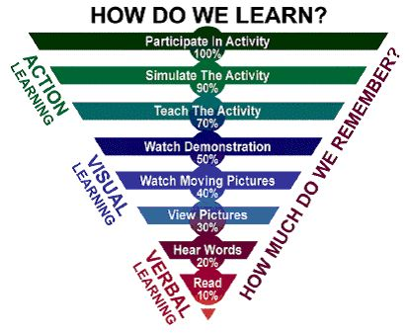
Realistic learners
Creative learners
Doers
Thinkers
Verbalisers
Visualisers
Notes:
When looking at the passport and developing the learning plan, ask how the new leader likes to learn, is she methodical and likes to do one module at a time, or prefers to see how many activities she can achieve in more than one module in any given meeting time.
She might prefer to have all of her thoughts written down for the reflection by the time you see her , or will only have dot points to remind her what each activity entailed or has taken photos to support each activity.
These are all valid
Realistic learners – activities one at a time module by module
Creative learners – multiple activities in any order
Doers – activities
Thinkers – reading and reflection exercises
Verbalisers – writing plans, taking notes, discussing
Visualisers – taking photos of activities

Slide 62
Learning approach of ALQP
Suited to all new Leaders and Managers, regardless of learning style
Learning tailored to her circumstances
Learning based on things she needs to do – so by time qualified will have done all the preparation to be a great Unit Leader or Manager

Slide 63
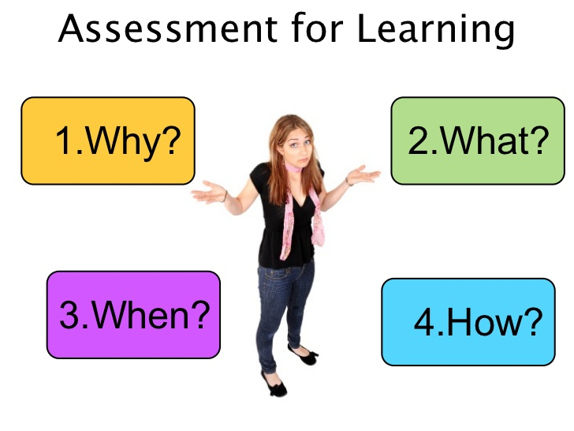
Ways Leaders Learn
Leadership Qualification is designed to cater to different learning styles of new Leaders and Managers
What are the ways new Leaders or Managers might like to learn best?
Notes:
Some leaders may like to be instructed, or asked their opinion on the best way to proceed, drawing on their other life experiences.
Many like to watch what you have done and then have a go or do mountains of research and document it then try the activity

Slide 64
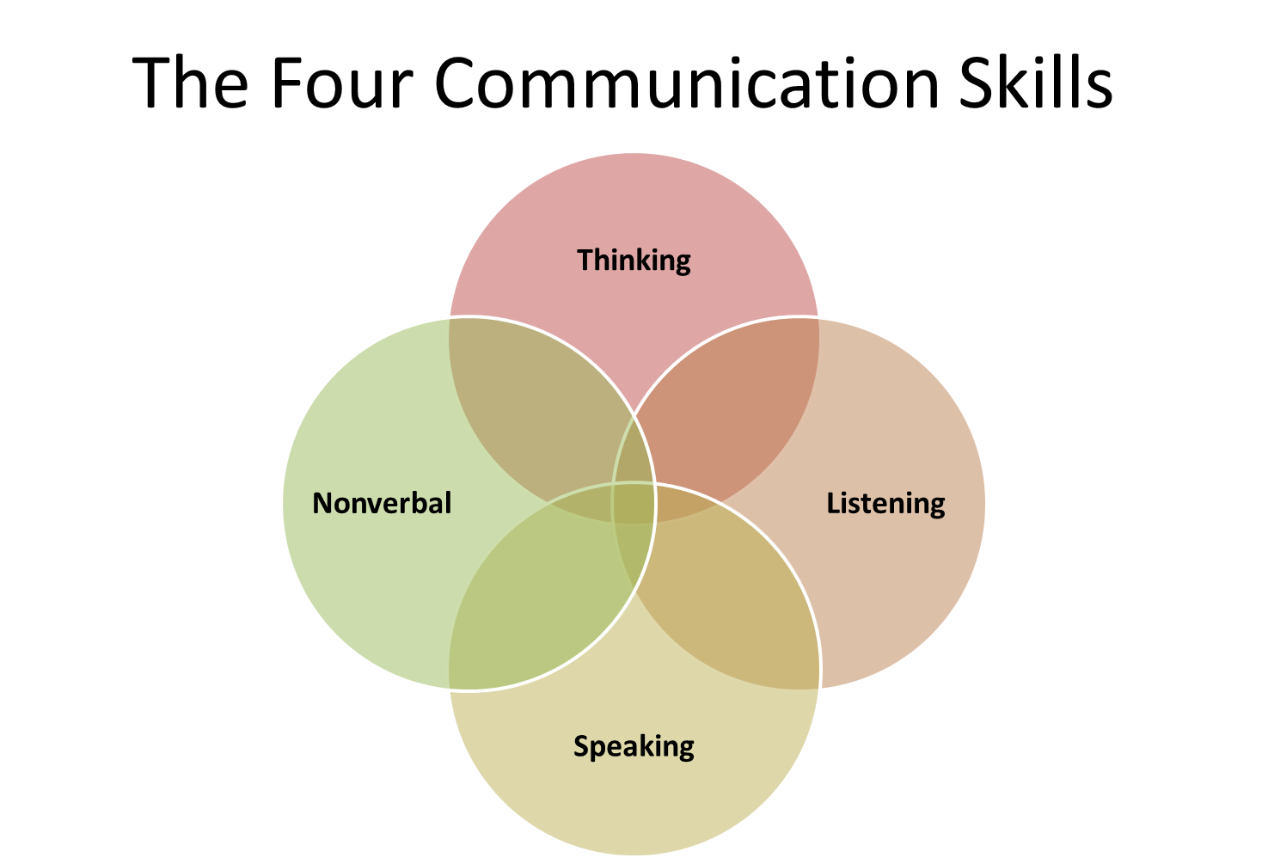
Fundamental Skills
Skills useful as Learning Partner, Leader, Colleague
Active Listening
  Orientating self to listener
  Using reflective techniques
Questioning
Observation
Coaching
Building trust

Slide 65

LP Skills - Observation
As Learning Partner you need to:
  listen and watch
  take notes and photos
  reflect on skills and knowledge used, any gaps, what done, atmosphere,
  Record key points in Passport – no need for additional paperwork
  And maybe tutor other Leaders/Managers on these skills.

Slide 66
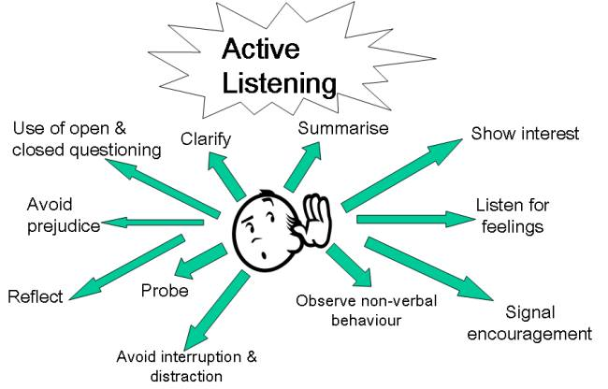
Active Listening
Notes:
Used in situations where trying to help the speaker deal with something / or where need to fully understand their perspective
Premise that speaker has answers so listener needs to orient self to speaker
Relies on listener using reflective techniques

Slide 67
Why active listening as a
Learning Partner?
Can increase your understanding of the new Leader
Can help to clarify new Leader’s thoughts
Can reassure the new Leader that you are willing to understand her point of view and to help

Slide 68

Orientation to the Speaker
Not “What can I do for this new Leader” but “How does this woman see herself and her situation?”
Empathy
Acceptance
Genuineness
Concreteness
Notes:
Empathy – understand her frame of reference
Acceptance – accept her
Genuineness – be open about yourself
Concreteness - focus on specifics

Slide 69
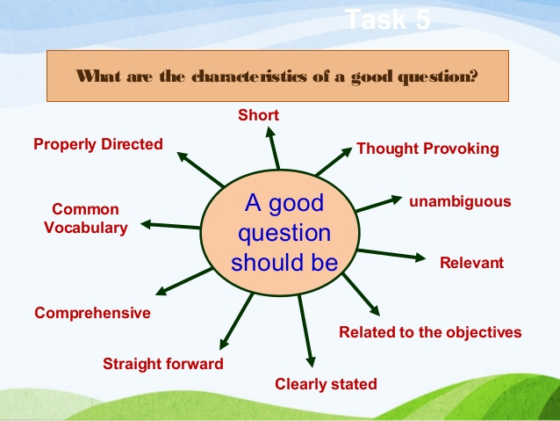
LP Skills – Questioning
Notes:
Other side of coin – the other’s point of view
More than asking open questions
Questions help to diagnose the issue/problem
Next set of questions moves speaker to offer solutions
How would you phrase questions to gain insight into how new Leaders progress?

Slide 70
Activity
Scenarios to practice questioning and listening skills
What questions would you ask
How would you reinforce you have heard the right thing?
Notes:
Ask about new leaders within their districts and how they were approached.
The other option is to use a fairy tale and look at it from the “baddie’s” point of view.
What questions would you ask to draw out their side of the story.

Slide 71
LP Skills - Coaching the new Leader
An introduction to coaching …
GROW model of coaching
Coaching skills
Coaching spectrum
Developing trust

Slide 72
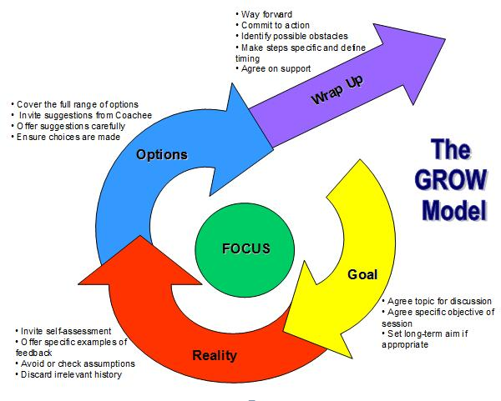

Slide 73
GROW model of coaching
Goals – what do you want?
Reality – what is happening now?
Options – what could you do?
Wrap up, way forward and will – what will you do?

Slide 74
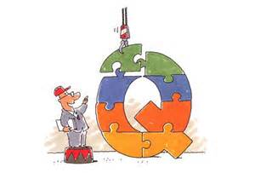
Grow model activity
Notes:
With the GROW model answer the questions to see how it works

Slide 75

LP Skills - Building trust
Presence – being authentic
Disclosure –timely sharing
Enquiry – seek and value
Commitment – consistency and reliability
Notes:
Presence – bring an authentic self and sustain focus, energy and openness
Disclosure – accurate, candid and timely sharing of personal thoughts and feelings
Enquiry – seek Leaders perspective and value her unique insight and wisdom
Commitment – consistency and reliability of follow through

Slide 76

How could you kill trust?
Notes:
Handout from WAGGGS on Building Trust

Slide 77

Offering only limited time
Not being readily available
Not being honest
Not returning calls, emails
Thinking about own issues and problems
Listening for the things you want to hear
Reporting conversation to others
Telling her what to do
Correcting her views and decisions

Slide 78

Steps to Qualification
Notes:
Run through the steps to qualification – there is a handout
Talk about the suggested timeframes for completion of the passport
Look at who does what in the process

Slide 79

Recognition of Prior Learning
Notes:
All our leaders come to us with a wealth of experience behind them, whether it be from an educational background, through a degree, or a career path or through other volunteer activities.
These need to be recognised and acknowledged.
The Guidance notes on page 24-25 have tables that show the automatic exemptions for youth members, overseas leaders and scout leaders
Ask trainees to look at these pages in their Guidance notes.
The bottom of the page shows what exemptions are available for youth members.
Page 25 shows exemptions for some professions and first aid exemptions.
This is by no means the whole list. We have to look at each person and what they are bringing to Guiding and see what we can credit them for.
Break into smaller groups and do the scenarios, a different one per group.
Allow a few minutes and bring group back together to discuss the results.

Slide 80

RPL standard of evidence
Current
Authentic
Relevant
Sufficient
Notes:
Current – within the last three years
Authentic – the new Leader / Manager must have carried out the activity herself
Relevant – the activity cited in the Passport, unless LP agrees an alternative
Sufficient – it must be the standard described in the Passport

Slide 81

  Aim is to value experiences of new Leaders / Managers
  If in doubt be generous UNLESS a “Being Safe” activity/requirement
  RPL outlined in the Passport is not finite – explore additional RPL
  If in doubt refer to State L&D Manager, who will put you in contact with the State RPL Liaison
  RPL opens communication
Notes:
In NSW/ACT our State RPL Liaison is Kerrie Hardie
Kerrie is happy for you to give all prospective LP’s her email contact details
kjhardie1@bigpond.com

Slide 82

Exercise on
Assessing RPL

Slide 83
Kirsty works at the local club as a shift manager and is an active volunteer with the local SES unit. She is 25 years of age and wants to be a Guide Leader for a Unit of 14-18 year olds.
She was involved in Guiding from the age of 7 but left when she turned 16 as there was not a suitable Guide Unit in the area.
What, if any, RPL can you grant her?

Slide 84
Answer
If she has a First Aid qualification – Being Safe: Basic Emergency Life Support
If she has a Basic Food Hygiene qualification – Being Safe: Activity 7 – Use safe food handling procedures during Unit meetings.
Notes:
Remember that this is the beginning of the RPL journey not the complete journey!
Asking questions and getting to know the NYQL/M will add to this list of activities
We MUST remember that women come into Guiding with experience and knowledge and education – both formal and informal – they are not empty vessels
Our role as a LP is to seek out that transferable knowledge and apply it to the Passport – just because we RPL an activity does NOT mean that the NYQL/M does not have to EVER complete that activity – the Passport is the role explained in activities – it is not surplus to the role!

Slide 85
Narelle is 35 years old and has been a Scout Leader for the last five years.
When her son turned 7 she decided to join Scouts as an Assistant Leader.
Now her daughter is turning 7, she wants to become a Guide Leader.
She has completed the Scout Leadership training, has a current First Aid certificate, and keeps the pack’s financial records.
On camp she is always Quartermaster.
What, if any, RPL can you grant her?

Slide 86
Answer
Being a Leader of your Unit – all activities
Being part of Guiding – a number of activities based on discussion with Learning Partner, if she is able to demonstrate acceptable knowledge and skill. The LP should verify judgement with State RPL Liaison.
Managing your Unit: Activity 5 – Keep financial records in accordance with SGGO policies for six weeks
Managing your Unit: Activity 6 - Budget for an event and discuss with District Manager
Being Safe: Provide Basic Emergency Life Support
Being Safe: Activity 7 – Use safe food handling procedures during Unit meetings.
Notes:
Refer to notes on previous slide

Slide 87

What skills and knowledge are required to put together a Learning Plan?

Slide 88

Knowledge of Leadership Passport, RPL rules
Familiarity with Managers, Leaders and Guide Handbooks,
Knowledge of State and First Aid trainings
Active listening
Questioning
Building trust
Creativity – thinking through options
Organising and planning etc.
Notes:
RPL rules and guidelines are in the Guidance notes, these give an overview of what can be accepted.
Every State has a RPL Liaison who is an experienced person within Guiding and can help work through any RPL situation

Slide 89

Learning Plan
Recognise Prior Learning
Review activities required
Schedule training
Schedule meetings with Learning Partner
Set date to renew or make Guide Promise
Set target date for qualification

Slide 90
Exercise on
identifying alternative activities
Notes:
Use the exercise from the original LP training

Slide 91

Wide scope for alternatives unless “Being Safe” activities
Encourage Leader to suggest ideas herself
Check suggestion for relevance and equivalence
Remember 36 activities in total, so being flexible on a few does not invalidate learning process

Slide 92
Summary of Learning Plan
Not just about filling out paperwork
Values experience
Builds confidence in ability to be Leader
Tailors learning to her circumstances
Develops relationship with you
Identifies any blockages

Slide 93

Exercise on Learning Plan
Discuss the process of putting together a Learning plan using the skills identified and who you would include in the process.
What questions would
you ask?
How would you build trust?
Notes:
If numbers are large enough and participants willing, a role play would suit this session.
This could also be a discussion about a leader recently joining one of the trainees districts
Look at the three scenarios, Olave Soames, Agnes Powell and Peggy Muir.
Facilitate the discussion on how you would put together their learning plans, using the skill taught today.

Slide 94

Progress Meetings

Slide 95
10 week term plan
Look at the term plan provided
Within this plan what activities from the passport can be signed off?
Notes:
After the exercise ask if this was worthwhile and point out that working as a team the NYQ leader can be signed off in as little as 10 weeks.

Slide 96
Outcomes of progress meetings
Reassure new Leader
Gain overall sense of where new Leader is at
Review progress against Learning Plan
Review sign-offs by other qualified Leaders
Sign-off Learning Partner activities, reading and reflections

Slide 97
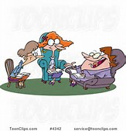
At the meeting
Be prepared to listen!
Ask questions!
Take notes!
Focus on the big picture!
Be clear on next steps! Update plan
Talk to District Manager
Notes:
When possible pre-plan your catch up meeting so they are in your diaries and you are not trying to fit them in around everything else.
It is easier to change the date than to make an initial date!
Go to the meeting knowing that you need to focus on the new leader.

Slide 98

At the meeting
Look at her passport
Show an interest in the activities achieved
Share some of your stories

Slide 99

Quality assurance of sign-offs
Check who has signed-off – check role right for sign-offs
Ensure legibility of name/signature
Ensure right evidence for that activity
Ensure sufficient notes on Passport
Check if good use being made of Program
If evidence required, check sufficiency
Review dates of sign-offs
As necessary coach qualified leaders on signing-off

Slide 100

Reflections on Modules
Using all the skills learnt today, how would you start the conversation for the reflection on each module
Would you use the same questions for each module?
Promise and Law is a personal journey, how could you get your new leader to feel comfortable about having this conversation?
Notes:
Go back to Olave, Agnes and Peggy and to initiate the discussion
What would you say to them.
If large enough group try it as a role play.

Slide 101

How much time do I allow with my NYQ Leader?
Notes:
Ask the question and promote discussion.
Time needed will depend on how much you have to mark off.
If you are meeting regularly then hour and half is probably sufficient. If you haven’t met for a while and she has almost finished you might need a few hours
It is important to give yourselves as much uninterrupted time as possible and if time is short, either reschedule or say at the beginning of the meeting I only have this much time what is the most important thing you need me to do.
Also discuss alternate ways to meet.
If distance is an issue, or work and family commitments.
You might be able to have a phone conversation with the passport being emailed
Or a skype meeting.
It is important to make it work

Slide 102
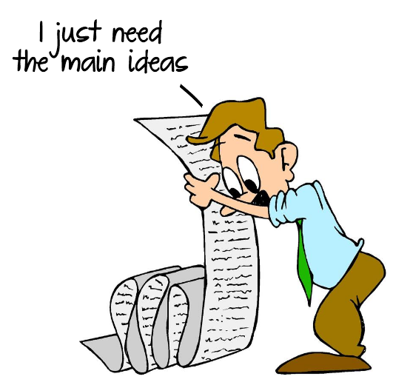
Summary

Slide 103

A new leader needs to be supported and feel part of the team
Learning Partner, qualified Leader and District Manager must work together to provide the team
All members of the team must be flexible
Accept third party evidence if provided and relevant
Notes:
Flexibility is essential to ensure the process continues to be short.
Don’t hold up the process because the new leader hasn’t been able to visit 2 units, the distance maybe too far and maybe talking with the leaders of other units at a region or state event may have the same result and move the process along.
Accept that other people are going to be present to witness some of the activities the NYQ Leader presents, accept this as it bolsters the NYQ Leaders confidence and speeds the process along

Slide 104

Modules don’t have to be done in order
Contact does not have to be face-to-face
The idea of the activities is to practice and learn from them. Get the NYQ Leader to reflect on how things could be done differently in different circumstances, even if they were a huge success.

Slide 105

Remember, it is an easy role which allows you to share your vast knowledge and experiences and help a new leader play the Game Of Guiding.

Slide 106

Questions

Slide 107

There is no teaching to compare with example.
If you make listening and observation your occupation you will gain much more than you can by talk.
Robert Baden-Powell

